Slide 1
Bayesian Hypothesis Testing (An A/B Test That Makes Sense)
By Alexander Booth

Slide 2
Bayesian Hypothesis Testing
Table of Contents:
Purpose
Scenario
Review of Classical Testing
Review of Bayesian Methodology
Hypothesis Testing of the Scenario
Conclusion

Slide 3
Bayesian Hypothesis Testing
Purpose:
This presentation will review current A/B test practices and delve into a new way of hypothesis testing by approaching the problem from a Bayesian point-of-view.

Slide 4
Bayesian Hypothesis Testing
Scenario:
We think that performing dynamic summarization without hidden specs will increase the visitor success rate for MIG Welding Supplies.

Slide 5
Bayesian Hypothesis Testing
Scenario:
We think that performing dynamic summarization without hidden specs will increase the visitor success rate for MIG Welding Supplies.
We created an A/B test, where version A is the default page, and version B is the page that has been dynamically summarized without hidden specs.

Slide 6
Bayesian Hypothesis Testing
Scenario:
We think that performing dynamic summarization without hidden specs will increase the visitor success rate for MIG Welding Supplies.
We created an A/B test, where version A is the default page, and version B is the page that has been dynamically summarized without hidden specs.
Half of our traffic to this page gets version A. The other half gets version B. We want to know which version of the page performed better.

Slide 7
Bayesian Hypothesis Testing
Classical Testing:
Needs:
Null/Alternative Hypotheses
Required Sample Size
Data

Slide 8
Bayesian Hypothesis Testing
Classical Testing:
Null Hypothesis:
Expresses the belief that the observed difference in outcomes is merely due to chance; i.e. the treatment had no effect
Does the data we gathered provide sufficient support to reject it?

Slide 9
Bayesian Hypothesis Testing
Classical Testing:
Sample Size:
The required sample size is calculated from the following:
Baseline’s current conversion rate
Minimum difference in performance desired to detect
Desired Statistical Power

Slide 10
Bayesian Hypothesis Testing
Classical Testing:
Great, we gathered our data. Now what?
Now that we have the samples, we can observe the performance of each variation
Then we can calculate whether the stronger performing variation is, in fact, better than its competitor in a statistically significant fashion

Slide 11
Bayesian Hypothesis Testing
Classical Testing:
Great, we gathered our data. Now what?
If the null hypothesis is true, we know that our data should behave in a certain way
We can formulate a statistic which, assuming the null hypothesis is true, behaves in a certain way

Slide 12
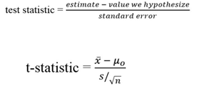
Bayesian Hypothesis Testing
Classical Testing:
Great, we gathered our data. Now what?

Slide 13

Bayesian Hypothesis Testing
Classical Testing:
Great, we gathered our data. Now what?
This follows a t-distribution with n - 1 degrees of freedom. Here x-bar is the sample mean, mu is the population mean, s/sqrt(n) is the standard error

Slide 14
Bayesian Hypothesis Testing
Classical Testing:
Great, we gathered our data. Now what?
"If the null hypothesis is true, what is the probability that we would observe a more extreme test statistic in the direction of the alternative hypothesis than we did?"

Slide 15
Bayesian Hypothesis Testing
Classical Testing:
Great, we gathered our data. Now what?
Using the known distribution of the test statistic, calculate the P-value
Set the significance level, α, the probability of making a Type I error. Typically .01, .05, .1

Slide 16
Bayesian Hypothesis Testing
Classical Testing:
Great, we gathered our data. Now what?
Compare the P-value to α.
If the P-value is less than (or equal to) α, reject the null hypothesis in favor of the alternative hypothesis.
If the P-value is greater than α, do not reject the null hypothesis.
Notes:
We say that if the value of the test statistic falls outside of the range where 95% of the values from a standard t’s distribution with that alpha and d.f. fall, we reject the null hypothesis at the 5% significance level. If it falls outside the 99% range, then we reject the null at the 1% level.
If it does fall outside that range, then we fail to reject the null at that level.

Slide 17
Bayesian Hypothesis Testing
Classical Testing:
Statistical Significance:
If the null were true, and α = .05, the value of our statistic would still fall outside the 95% interval 5% of the time by definition.
We would erroneously reject the null 5% of the time!

Slide 18
Bayesian Hypothesis Testing
Classical Testing:
Statistical Significance:
We rejected the null based on our data, but this would happen 5% of the time even if the null were actually true.
This is the precursor to the multiple comparison problem and Bonferonni correction, but I will not get into that here.

Slide 19

Bayesian Hypothesis Testing
A “Quick” Note on P-Values
P-values are NOT optimistic

Slide 20
Bayesian Hypothesis Testing
A “Quick” Note on P-Values
We start with a pessimistic hypothesis stating that the newly introduced variation B is not any better than the existing baseline A
The observed differences represent
nothing more than random noise.

Slide 21
Bayesian Hypothesis Testing
A “Quick” Note on P-Values
Drawbacks:
We need to know how much of the data we need to collect for the test before starting the test.

Slide 22
Bayesian Hypothesis Testing
A “Quick” Note on P-Values
Drawbacks:
We need to know how much of the data we need to collect for the test before starting the test.
We can’t test the result in real-time until we collect a full of the planned data size.

Slide 23
Bayesian Hypothesis Testing
A “Quick” Note on P-Values
Drawbacks:
We need to know how much of the data we need to collect for the test before starting the test.
We can’t test the result in real-time until we collect a full of the planned data size.
The test result is not intuitively understandable especially for those without a statistical background.

Slide 24
Bayesian Hypothesis Testing
A “Quick” Note on P-Values
Drawbacks:
We need to know how much of the data we need to collect for the test before starting the test.
We can’t test the result in real-time until we collect a full of the planned data size.
The test result is not intuitively understandable especially for those without a statistical background.
The test result is binary, either it is statistically significant or not. Therefore, it’s hard to figure out what to do especially when it is not statistically significant.

Slide 25
Bayesian Hypothesis Testing
A “Quick” Note on P-Values
The test result is binary, either it is statistically significant or not.
Therefore, it’s hard to figure out
what to do especially when it is not
statistically significant.

Slide 26
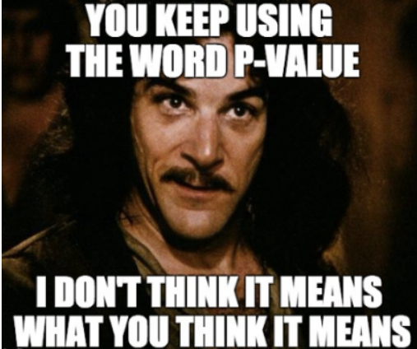
Bayesian Hypothesis Testing

Slide 27
Bayesian Hypothesis Testing
A “Quick” Note on P-Values
The p-value DOES NOT represent the probability that variation B is really better than A.

Slide 28
Bayesian Hypothesis Testing
A “Quick” Note on P-Values
The p-value DOES represent the probability that the results we see could come from the Null Hypothesis being true.

Slide 29
Bayesian Hypothesis Testing
A “Quick” Note on P-Values
Can we do something to make things:
simpler
less restrictive
more reliable
more intuitive

Slide 30


Bayesian Hypothesis Testing
A “Quick” Note on P-Values
YES

Slide 31
Bayesian Hypothesis Testing
Bayesian Basics
There exists an (unknown) parameter θ∈[0,1]
A unique visitor who visits our MIG Welding Supplies page will have a success action with probability θ
θ is our true success rate

Slide 32

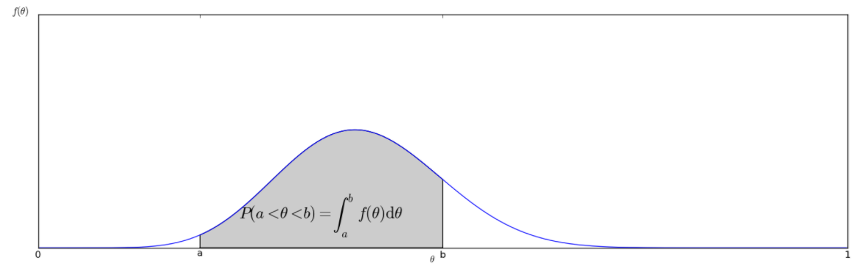
Bayesian Hypothesis Testing
Bayesian Basics

Slide 33

Bayesian Hypothesis Testing
Bayes’ Rule
Update f(θ), our belief, based on evidence

Slide 34
Bayesian Hypothesis Testing
Bayes’ Rule
P(fact) is our Prior distribution and is purely subjective. It represents our beliefs before we have gathered any evidence
P(fact|evidence) is our Posterior distribution and is our estimator of f(θ)

Slide 35

Bayesian Hypothesis Testing
Beta Distribution
A common choice for the underlying choice of model is the Beta Distribution
The Beta Distribution is used for both the Prior function and the Posterior function

Slide 36
Bayesian Hypothesis Testing
Beta Distribution
the Beta distribution can be understood as representing a distribution of probabilities
It represents all the possible values of a probability when we don't know what that probability is

Slide 37
Bayesian Hypothesis Testing
Calculating Posterior
Confused? Don’t be! Here are 4 Easy Steps:
Step 1: Pick a prior. f(1,1) or f(0,0) are good choices
Step 2: Observe N trials, with K success and F failures
E.g 794 people saw the ad, 12 signed up, 782 didn’t
Step 3: Do simple addition to calculate new alpha or beta. This is optional if you pick the f(0,0) prior
Step 4. New Alpha = Prior Alpha + K = 1 + 12 = 13
New Beta = Prior Beta + F = 1 + 782 = 783

Slide 38
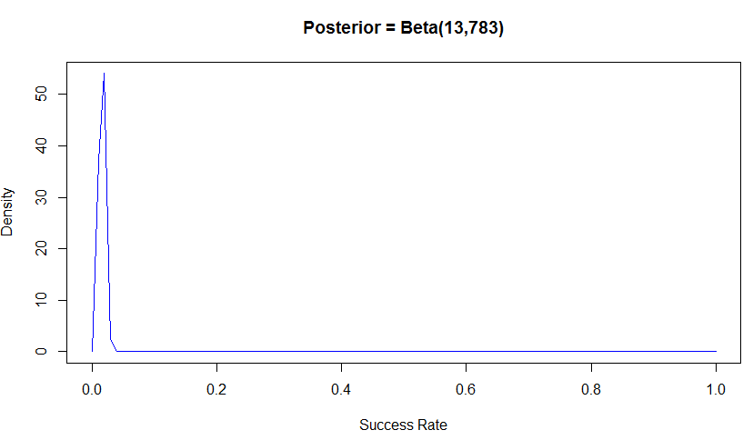
Bayesian Hypothesis Testing
Calculating Posterior

Slide 39
Bayesian Hypothesis Testing
Bayes Recap
Define the prior distribution that incorporates your subjective beliefs about a parameter. The prior can be uninformative or informative.
Gather data.
Update your prior distribution with the data using Bayes’ theorem to obtain a posterior distribution.
Analyze the posterior distribution and summarize it

Slide 40
Bayesian Hypothesis Testing
Classical vs Bayesian Parameter Estimation
In the Bayesian approach, the parameters that we are trying to estimate are treated as random variables.
Random variables are governed by their parameters (mean, variance, etc), and distributions (Gaussian, Poisson, binomial, etc).

Slide 41
Bayesian Hypothesis Testing
Classical vs Bayesian Parameter Estimation
In the frequentist approach, they are fixed, albeit within a confidence interval
We can think of the Bayesian approach as defining parameters as a probability distribution while classical parameter estimations are fixed estimates.

Slide 42
Bayesian Hypothesis Testing
Hypothesis Testing
Let’s go back to our scenario.
We looked at dynamically summarizing MIG Welding Supplies without hidden specs and performed an A/B test

Slide 43
Bayesian Hypothesis Testing
Hypothesis Testing
After we gathered our data, we saw that we had 2686 total Visits assigned to the test. 1330 were assigned to Variant A and 1356 were assigned to Variant B.
For the customers in Variant A, we had 146 successes and 1184 failures. This equates to a sample probability success rate of .11.
For the customers in Variant B, we had 168 successes and 1188 failures. This equates to a sample probability of success rate of .123.

Slide 44
Bayesian Hypothesis Testing
Hypothesis Testing
I just did a simple binomial test for this, instead of trying to explain all of our complicated t-test regression code.
The Binomial test performs an exact test of a simple null hypothesis about the probability of success in a Bernoulli experiment.
But this is still a classical method.

Slide 45
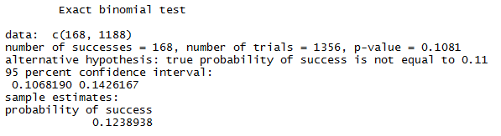
Bayesian Hypothesis Testing
Hypothesis Testing

Slide 46
Bayesian Hypothesis Testing
Hypothesis Testing
Darn, our p-value is not statistically significant.
Since .11 falls into the confidence interval, we fail to reject the null hypothesis that the probability of success for Variant B is equal to that of Variant A.
Our actual p-value from the t-test regressions was also not significant, with a p-value of .255

Slide 47
Bayesian Hypothesis Testing
Hypothesis Testing
Now, on to the Bayesian way

Slide 48

Bayesian Hypothesis Testing
Hypothesis Testing
Now, on to the Bayesian way

Slide 49
Bayesian Hypothesis Testing
Hypothesis Testing
Given what we already know about parameter estimation, we can look at each of these Group success rates as two different parameters that we're trying to estimate.

Slide 50
Bayesian Hypothesis Testing
Hypothesis Testing
Given what we already know about parameter estimation, we can look at each of these Group success rates as two different parameters that we're trying to estimate.
I used a prior of Beta(1,1).
This means the posterior for Group 1 is Beta(147, 1185).
Likewise, the posterior for Group 2 is Beta(169, 1189).

Slide 51
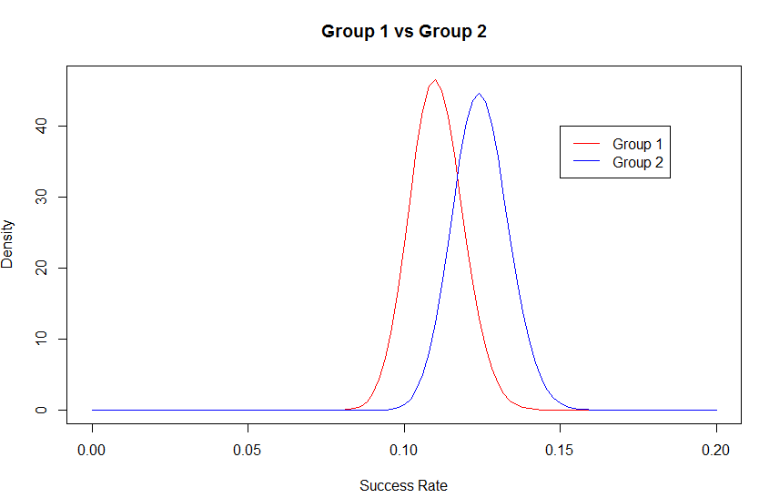
Bayesian Hypothesis Testing
Hypothesis Testing

Slide 52
Bayesian Hypothesis Testing
Hypothesis Testing
Clearly our data suggests that Variant B is the superior variant.
However, from our earlier discussion on Parameter Estimation we know that the true conversion rate can be a range of possible values.
We can also clearly see here that
there is an overlap between the
possible true conversion rates for
Groups 1 and 2.

Slide 53
Bayesian Hypothesis Testing
Hypothesis Testing
What if we got unlucky in our Variant A responses and its true conversion rate is in fact much higher?
What if we were also really lucky with Variant B and its conversion rate is in fact much lower?
The real question we have is
how likely is it that Variant B is
actually the better variant?

Slide 54
Bayesian Hypothesis Testing
Monte Carlo Simulation
I'm a huge fan of Monte Carlo Simulations!
The basics of a Monte Carlo simulation are simply to model your problem, and then randomly simulate it until you get an answer.
It’s useful for modelling integration, approximations, and probabilities. However, many simulations are required for the results to be statistically valid.

Slide 55
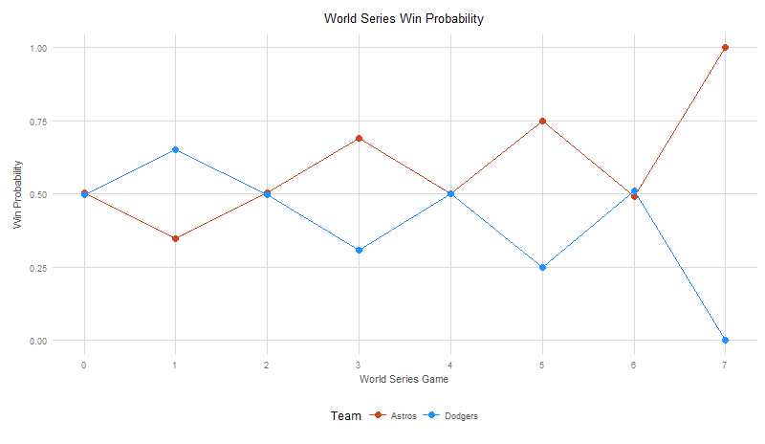
Bayesian Hypothesis Testing
Monte Carlo Simulation
In fact that’s what I used to simulate the World Series 100,000 to predict a winner!

Slide 56
Bayesian Hypothesis Testing
Monte Carlo Simulation
But anyway, we'll just simply sample 100,000 times from each distribution we have modeled here and see what it tells us. The results can literally answer "What is the probability that Variant B is actually superior to Variant A“

Slide 57

Bayesian Hypothesis Testing
Monte Carlo Simulation

Slide 58
Bayesian Hypothesis Testing
Monte Carlo Simulation
The probability that Group B is superior is .87099

Slide 59
Bayesian Hypothesis Testing
Magnitude vs Significance
The focus of a classic Null-Hypothesis Significance Tests is to establish whether two different samples are likely to be the result of sampling from the same distribution or not.
Statistical Significance can at most tell us "these two things are not likely the same", as this is what rejecting the Null Hypothesis is saying.
That's not really a great answer for an A/B Test.

Slide 60
Bayesian Hypothesis Testing
Magnitude vs Significance
We're running this test because we want to improve Success Rates. Results that say “Variant B will probably do better" are okay, but don't you reallyyyyy want to know how much better?
Classical statistics tells us Significance, but what we should also look at is Magnitude.

Slide 61
Bayesian Hypothesis Testing
Magnitude vs Significance
By simply plotting the ratio of b.samples and a.samples, we will get a distribution of the relative improvements we've seen in our simulations.

Slide 62
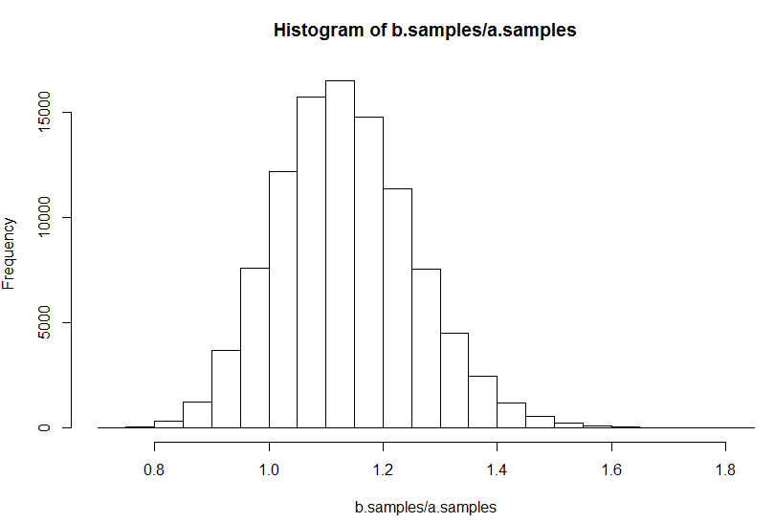
Bayesian Hypothesis Testing
Magnitude vs Significance
By simply plotting the ratio of b.samples and a.samples, we will get a distribution of the relative improvements we've seen in our simulations.

Slide 63
Bayesian Hypothesis Testing
Magnitude vs Significance
From this histogram we can see that our most likely case is about a 13% improvement over A, but we can see an entire range of values. The Cumulative Distribution Function (CDF) is much more useful for reasoning about our results over an entire range.

Slide 64
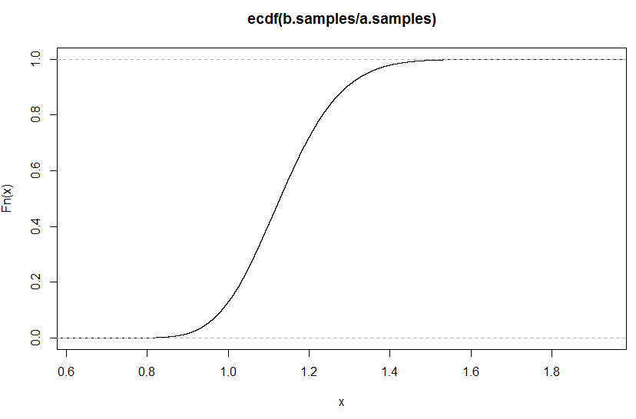
Bayesian Hypothesis Testing
Magnitude vs Significance

Slide 65
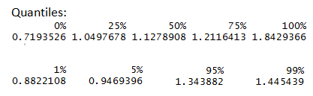
Bayesian Hypothesis Testing
Magnitude vs Significance
Now we can see that there is really just a small chance that Variant A is better, but even if it is better it's not going to be better by all that much.
We can also see that there's about a 25% chance that Variant B is a 21% or more improvement over Variant A!

Slide 66
Bayesian Hypothesis Testing
Magnitude vs Significance
Now in choosing Variant B over Variant A we can actually reason about our risk!

Slide 67
Bayesian Hypothesis Testing
Magnitude vs Significance
Now in choosing Variant B over Variant A we can actually reason about our risk!
"The chance that Variant B is 5% worse is roughly the same that it's 34% better."

Slide 68
Bayesian Hypothesis Testing
Magnitude vs Significance
Now in choosing Variant B over Variant A we can actually reason about our risk!
"The chance that Variant B is 12% worse is roughly the same that it's 45% better."

Slide 69
Bayesian Hypothesis Testing
Magnitude vs Significance
Sounds like a good bet to me, and a much better statement of our knowledge than:
"There is not a Statistically Significant chance that Variant B is better than Variant A."

Slide 70
Bayesian Hypothesis Testing
Summarize in 2 Sentences:
In summary, the difference is that in the Bayesian view, a probability is assigned to a hypothesis.
In the frequentist view, a hypothesis is tested without being assigned a probability.

Slide 71
Bayesian Hypothesis Testing
How can we test the Bayesian hypothesis testing approach?
I recommend looking at past tests or one that is concurrently being analyzed in the traditional way.
By setting a probability cutoff of .95, we can compare what is “statistically significant” against the Bayesian .95 probability limit

Slide 72
Bayesian Hypothesis Testing
How can we test the Bayesian hypothesis testing approach?
I actually already looked at the entire dynamic summarization with hidden specs test. Every page that had a p-value of less than .05 also had a Bayesian probability of greater than .95.
Further, terms that were on the edge, perhaps with a .06 or .07 p-value, actually squeaked in with a Bayesian probability of greater than .95.

Slide 73
Bayesian Hypothesis Testing
How can we test the Bayesian hypothesis testing approach?
HOWEVER
Instead of focusing on statistically significant, I hope this presentation brought out a potential new point of view in regards to magnitude and probability.
The example in the scenario was a real example. Although it was not “statistically significant”, it is hard not to see the potential benefits of releasing Variant B.

Slide 74
Bayesian Hypothesis Testing
Questions?

